Slide 1
C
Variables

Slide 2
Our Plan for Today…
Variables (again?!)
Pointers
Arrays

Slide 3
Variables
C allows you to use different types of variables
Why do we need different types?
Validation
Features (like fraction)
Use data efficiently
Basic Types in C:
int (long long, long, short)
char (ASCII)
wchar_t (UNICODE)
float
double (long)

Slide 4
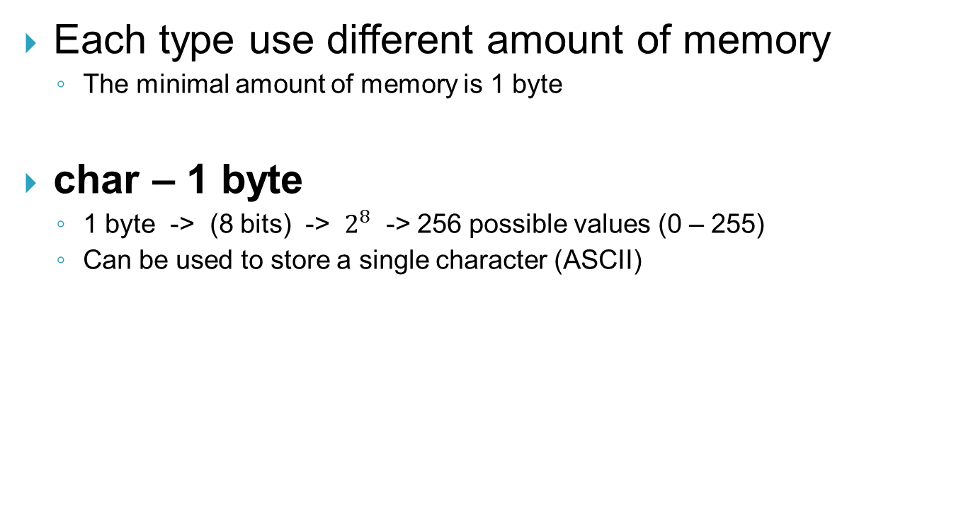
The size of Variables
Each type use different amount of memory
The minimal amount of memory is 1 byte
char – 1 byte
1 byte -> (8 bits) -> $2^{8}$ -> 256 possible values (0 – 255)
Can be used to store a single character (ASCII)

Slide 5
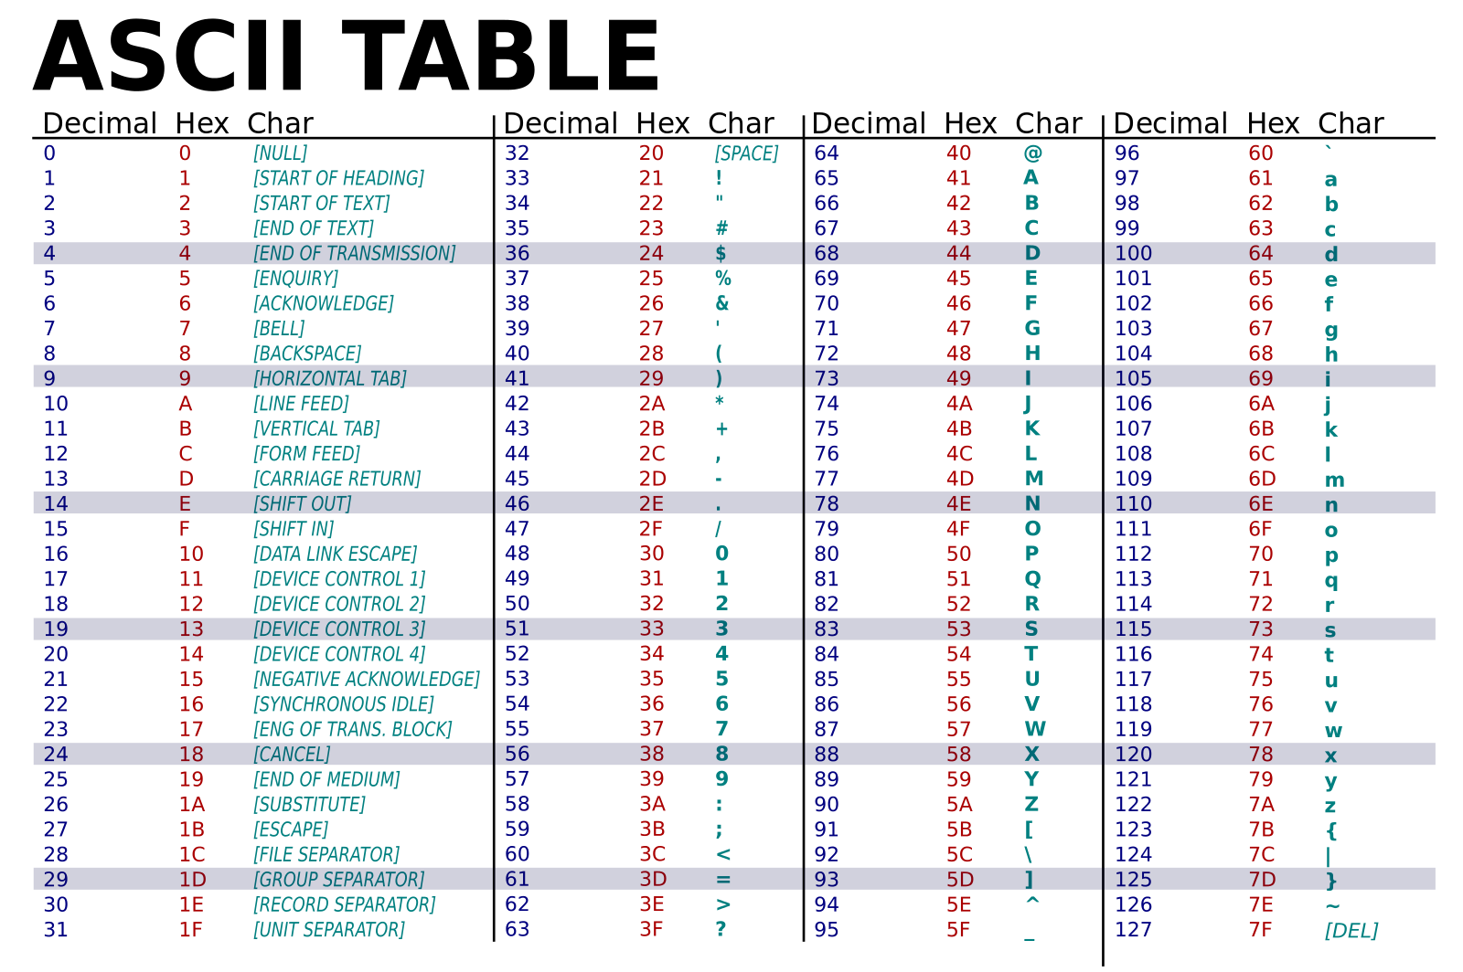
The size of Variables

Slide 6
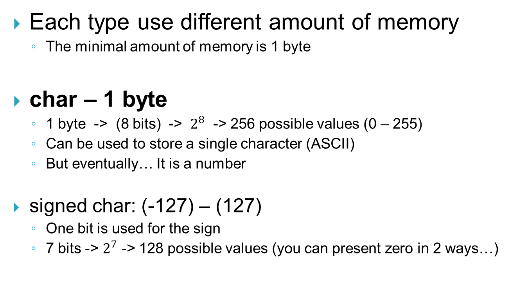
The size of Variables
Each type use different amount of memory
The minimal amount of memory is 1 byte
char – 1 byte
1 byte -> (8 bits) -> $2^{8}$ -> 256 possible values (0 – 255)
Can be used to store a single character (ASCII)
But eventually… It is a number
signed char: (-127) – (127)
One bit is used for the sign
7 bits -> $2^{7}$ -> 128 possible values (you can present zero in 2 ways…)

Slide 7
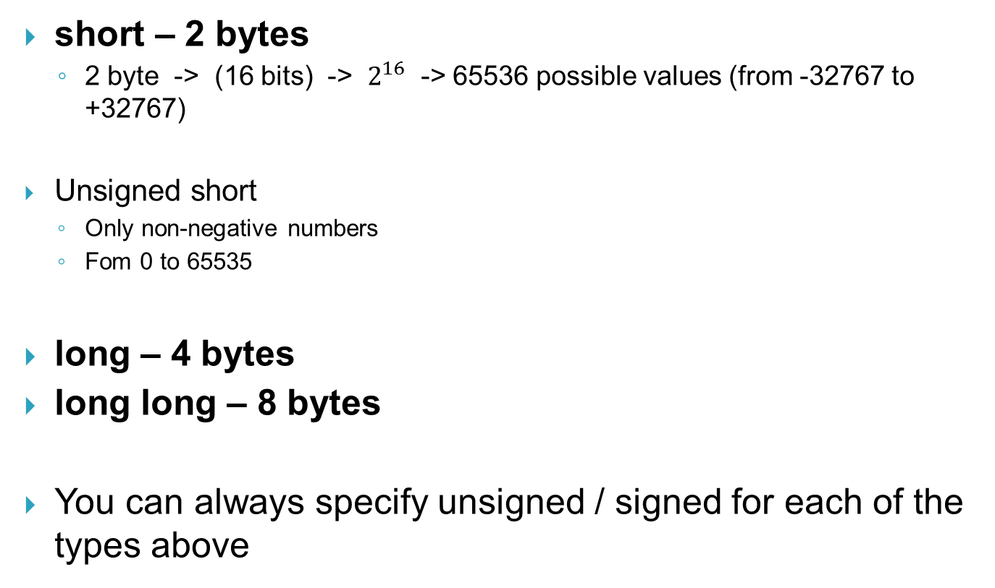
The size of Variables
short – 2 bytes
2 byte -> (16 bits) -> $2^{16}$ -> 65536 possible values (from -32767 to +32767)
Unsigned short
Only non-negative numbers
Fom 0 to 65535
long – 4 bytes
long long – 8 bytes
You can always specify unsigned / signed for each of the types above

Slide 8
The size of Variables
int – at least 4 bytes
The size of this type varies between platforms
float, double, long double
Used for fractional numbers
Size vary
The function sizeof() can be used to find the variable size

Slide 9
“The Memory”
We created a variable
A place in the memory was allocated
What is it’s size?
Where?
The memory is divided into bytes
Those bytes can be accessed by address
Notes:
This is not totally true, but the main goal is to pass the idea

Slide 10
“The Memory”
Each square represent a byte
0 1 2 4 5 6 7 8 … 15
16
32
48
64
Notes:
This is not totally true, but the main goal is to pass the idea

Slide 11
“The Memory”
Each square represent a byte
0 1 2 4 5 6 7 8 … 15
16
32
48
64
 |  |  |  |  |  |  |  |  | 123
Address 16
char a = 123;
Notes:
This is not totally true, but the main goal is to pass the idea

Slide 12
“The Memory”
Each square represent a byte
0 1 2 4 5 6 7 8 … 15
16
32
48
64
 |  |  |  |  |  |  |  |  | 123
 |  | 0
Address 36-39
long c = 0;
Notes:
This is not totally true, but the main goal is to pass the idea

Slide 13
Pointers
In order to store addresses in the memory we use pointers
Pointer is actually a variable that holds a number
This number is the address in the memory
The size of this variables depends on the platform
On 32 bit systems – the size is 32 bit → 4 bytes
On 64 bit systems – the size is 64 bit → 8 bytes

Slide 14
Pointers
When creating a pointer, you need to specify the type of data it is pointing to
char *p;
The * sign means that p is a pointer to a char object.
But for now.. It is only a simple variable

Slide 15
Pointers
Each square represent a byte
0 1 2 4 5 6 7 8 … 15
16
32
48
64
 |  |  |  |  |  |  |  |  | 123
 |  | 0
 |  |  |  |  |  | ???
char* p;
Notes:
Can they guess the platform used for this example?

Slide 16
Pointers
Now let’s look on the following code:
Ctrl+F5 … (Run)
What happened here?
char c = 44;
char* p;
p = &c;
printf(“%d”, c);
printf(“%d”, p);
printf(“%d”, *p);
Output: 44
Output: 16
Output: 44

Slide 17
Pointers
The ‘&’ sign is used to get the address in which the variable is stored

Slide 18
“The memory”
Each square represent a byte
0 1 2 4 5 6 7 8 … 15
16
32
48
64
 |  |  |  |  |  |  |  |  | 44
 |  | 0
 |  |  |  |  |  | ???
Notes:
Can they guess the platform used for this example?

Slide 19
Pointers
The ‘&’ sign is used to get the address in which the variable is stored
In this case we got 16
The ‘*’ sign is used to access the data which the pointer points to
The type of the pointer define how much data will be read
Note that ‘*’ is used for two different purposes
Creating a pointer (char*, int* and so…)
Accessing data

Slide 20
“The memory”
Each square represent a byte
0 1 2 4 5 6 7 8 … 15
16
32
48
64
 |  |  |  |  |  |  |  |  | 44
 |  | 0
 |  |  |  |  |  | 16
Notes:
Can they guess the platform used for this example?

Slide 21
Pointer Arithmetic
+ and - can be used to reference addresses following or preceding the one currently pointed to
Note that integers can be added to or subtracted from pointers, but not the other way around!
int * p = &i; p += 4; p –= i;
The size of the “step” used depends on the size of the data type pointed to
int’s are 4 bytes long, char’s are a single byte

Slide 22
Arrays
Array is a pointer to a group of the same type
short c[3]; // create an array of 3 short integers

Slide 23
Arrays
Each square represent a byte
0 1 2 4 5 6 7 8 … 15
16
32
48
64
 |  |  |  |  |  |  |  |  | 123
 |  | 0
 |  |  |  |  |  | ???
short c[3];
Notes:
Can they guess the platform used for this example?

Slide 24
Arrays
Array is a pointer to a group of the same type
short c[3]; // create an array of 3 short integers
c now stores an address
(In our example the address is 2)
This is the address of the first element

Slide 25
Arrays
C array are zero-based
To reference a specific element, use []
c[2] = 3;
This is done exactly like pointer arithmetic
In fact, you can use [] with regular pointers
Caution! C does not check for out-of-bounds indices

Slide 26
Arrays
c[0] = 2;
*c = 2;
What is the difference?
It is actually the same…
c[1] = 5;
*(c + 1) = 2;

Slide 27
Arrays
Unlike pointers, the address pointed to by the variable cannot be changed
Like other variables, you can provide an initial value for an array
int a[5] = { 1, 2, 3, 4, 5 };
int zeroes = { 0 };
Two Dimensional
Int a[2][2] = { {0,1} , {2,3} }

Slide 28
Strings
Strings are actually array of chars.
char* s = “Hello World”;
s[0] == ‘H’;
char s[] = “Hi”;
char s[10] = “Hello”;
Strings are null terminated (indicating end of string)
s[11] == ‘\0’;
Caution! For N size string you need N+1 size array!

Slide 29
…and a bonus
void* p;
Points to an address of unknown type
Arithmetic and [] operator will result in compilation error
Should be used with proper casting
p[0] = 1; /* bad */
((int*)p)[0] = 1; /* good */

Slide 30
Play time

Slide 31


